Slide 1
DATA VISUALIZATION · FINAL INDIVIDUAL PROJECT · SUMMER 2026
The Steam Marketplace,
2004–2018
Pricing, popularity, and quality across 26,643 real Steam releases — and what they reveal about how the PC games market industrialized.
Prepared for: Data Visualization Course

Slide 2
PROJECT OVERVIEW
One dataset. Twelve questions. One story.
01
02
03
04
Choose a real dataset
Ask analytical questions
Build publication visuals
Ship an interactive dashboard
26,643 Steam games (2004–2018), scraped from Steam/SteamSpy via TidyTuesday — real-world, rich, and varied.
12 multi-dimensional questions relating price, ownership, playtime, quality, and time.
12 Plotly figures — CVD-safe, decluttered, explanatory titles — in a Jupyter notebook.
A 4-tab Streamlit app with live filters, deployed on Streamlit Community Cloud.
Final Individual Project · Data Visualization · Summer 2026
2

Slide 3
THE DATASET
26,643 games. Four attribute types. Fifteen years.
Source: Steam Store + SteamSpy scrape, distributed via the R for Data Science community's TidyTuesday project (week of 2019-07-30). Real-world data, not a synthetic teaching set.
26,643
games analyzed
Attribute type | Columns
Numerical | price, average_playtime, median_playtime, metascore, owners_est
Categorical | developer, publisher, owners (ordinal bracket), price_tier
Temporal | release_date, release_year, release_month
Text | game (title) — length, word count, sequel/edition markers
2004–2018
release-year span
~10.7%
have a Metacritic score
Final Individual Project · Data Visualization · Summer 2026
3

Slide 4
METHODOLOGY
From raw scrape to analysis-ready table
1
Parse & filter
2
Fix a hidden bug
Parsed release_date; kept 2004–2018 full calendar years to avoid partial-year 2019 bias.
The owners column used non-breaking spaces (\xa0) instead of regular spaces — silently broke every category match until caught and normalized.
3
Engineer features
4
Handle missingness honestly
price_tier (5 bins), owners_est (bracket midpoint), title text stats, developer/publisher catalog size, playtime-skew index.
metascore = 0 recoded as missing (not “bad”); has_critic_score flag added instead of silently imputing.
Final Individual Project · Data Visualization · Summer 2026
4

Slide 5
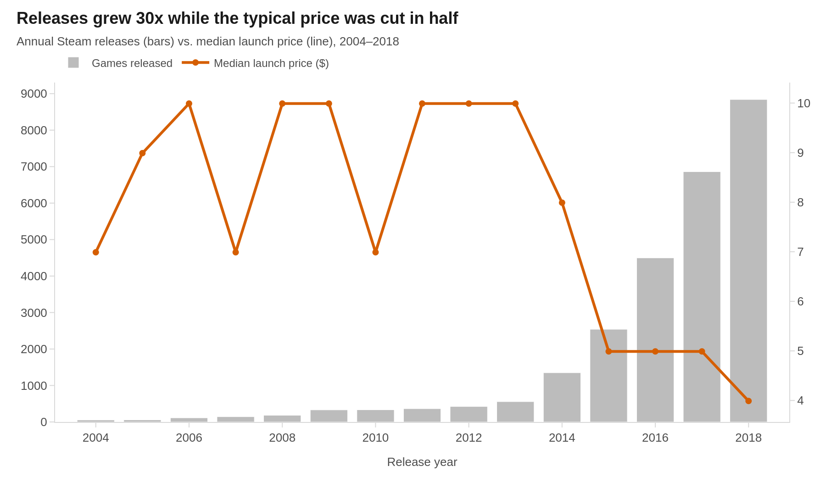
Q1 · MARKET GROWTH
Releases grew 30× while the typical price was cut in half
KEY TAKEAWAY
Annual Steam releases exploded from dozens in the mid-2000s to nearly 9,000 by 2018, driven by Greenlight/Direct opening the platform to indie developers. Median launch price fell from ~$10– 15 to under $6 over the same period — the market shifted from scarce & premium to abundant & cheap.
Final Individual Project · Data Visualization · Summer 2026
5

Slide 6
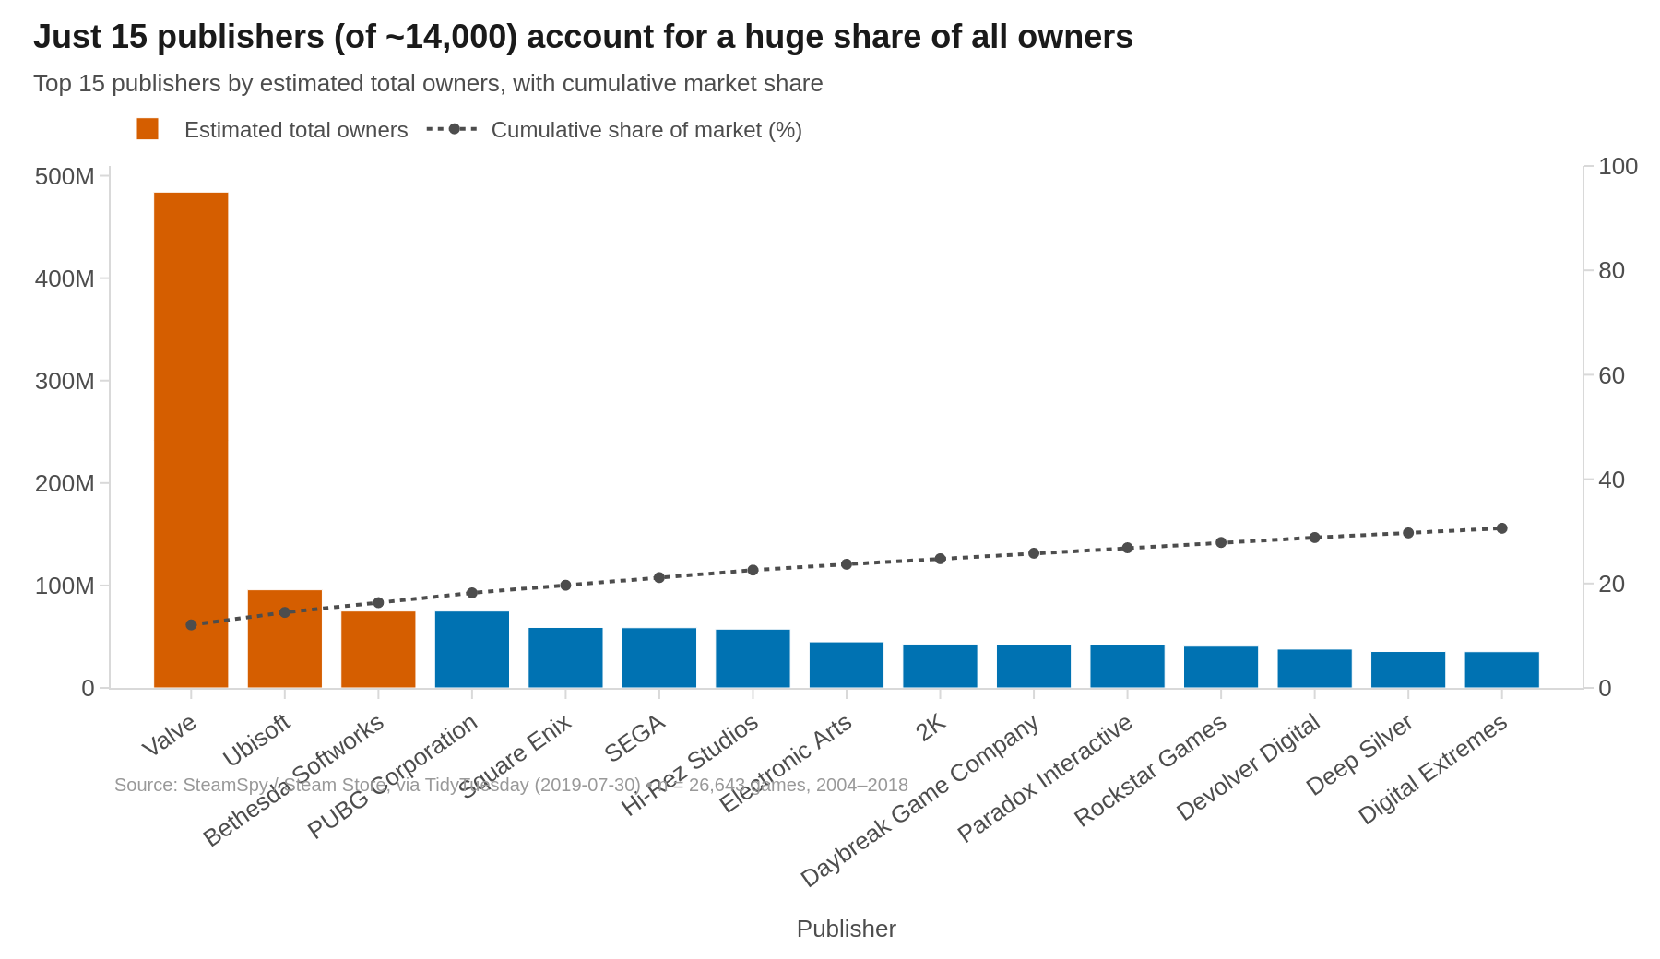
Q4 · MARKET STRUCTURE
15 publishers (of ~14,000) control a huge share of the market
KEY TAKEAWAY
This is a classic long-tail market. Valve and a handful of major publishers hold a disproportionate share of total estimated ownership, while tens of thousands of small publishers each hold a sliver of the pie.
Final Individual Project · Data Visualization · Summer 2026
6

Slide 7
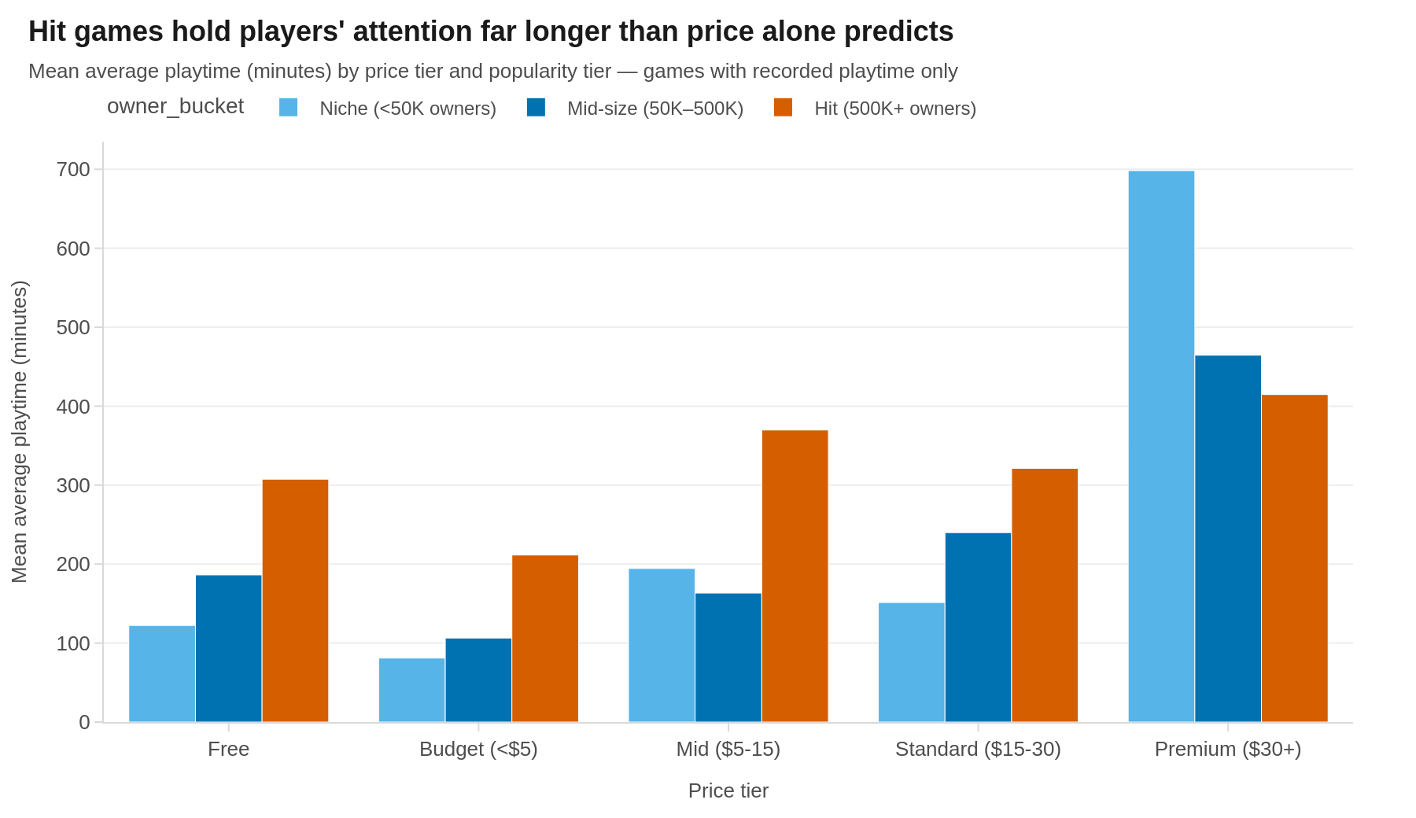
Q3 · ENGAGEMENT
Popularity — not price — drives playtime
KEY TAKEAWAY
Within every price tier, “Hit” games rack up far more average playtime than niche titles at the same price point. Paying more does not reliably buy more engagement — popularity dominates.
Final Individual Project · Data Visualization · Summer 2026
7

Slide 8
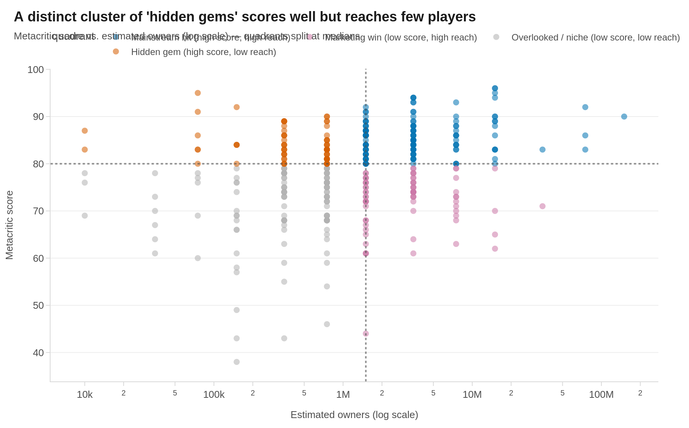
Q6 · DISCOVERY
A cluster of ‘hidden gems’ scores well but reaches few players
KEY TAKEAWAY
A meaningful share of critically strong games never find a large audience. Steam's discovery problem is real — quality alone is far from sufficient for commercial reach.
Final Individual Project · Data Visualization · Summer 2026
8

Slide 9
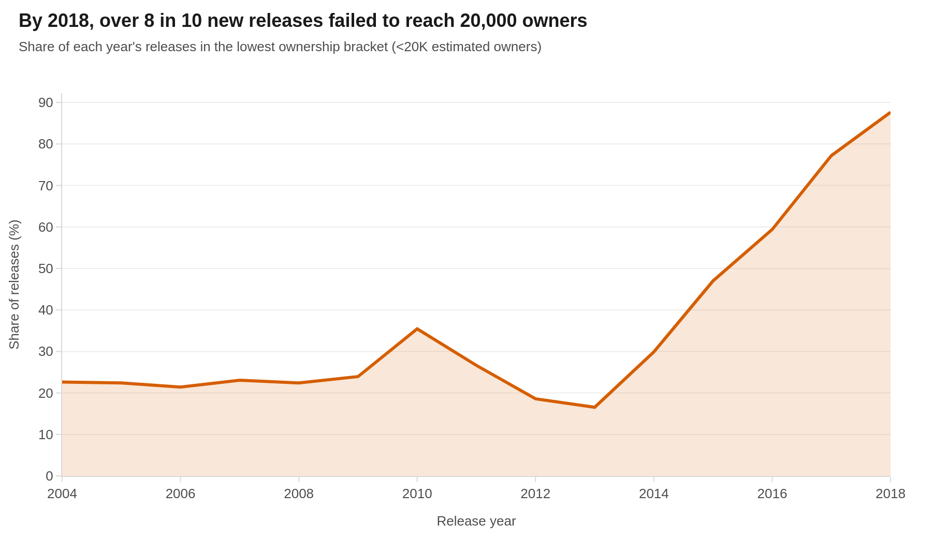
Q11 · LONG TAIL
By 2018, over 8 in 10 new releases failed to reach 20K owners
KEY TAKEAWAY
As releases multiplied post-2014, the share of games stuck in the lowest ownership bracket rose sharply. More releases chasing a similarly sized player base means the median new game is increasingly likely to go unnoticed.
Final Individual Project · Data Visualization · Summer 2026
9

Slide 10
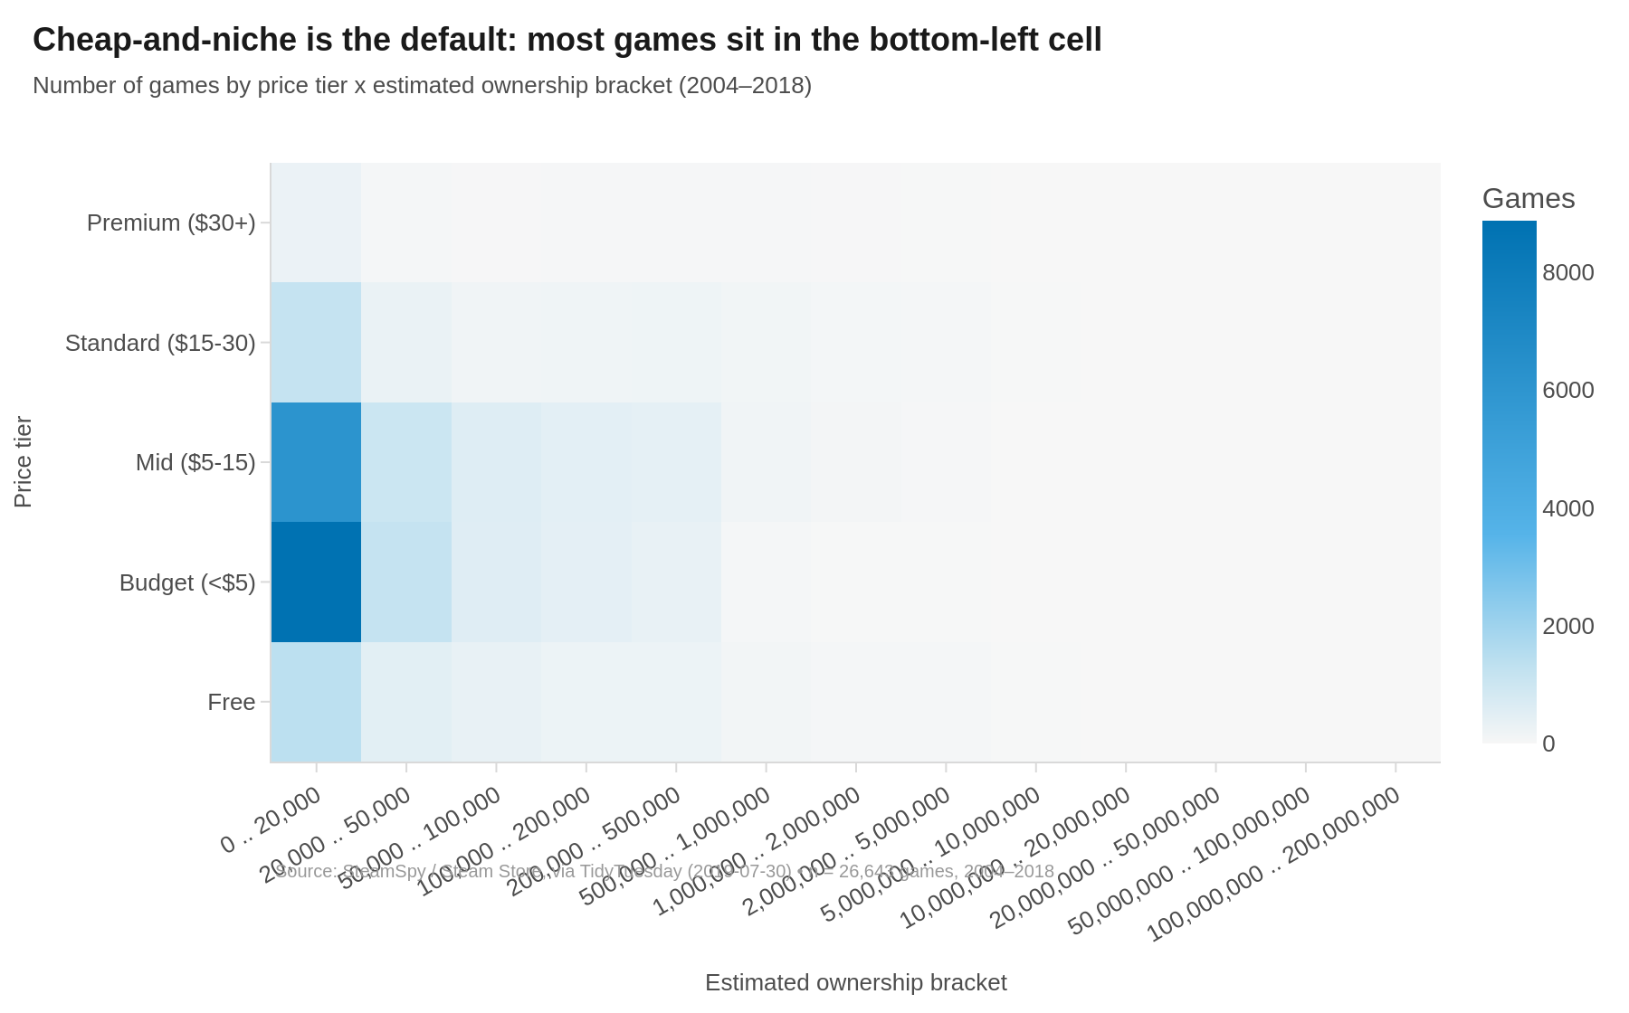
Q12 · CATALOG STRUCTURE
Cheap-and-niche is the default state of the catalog
KEY TAKEAWAY
The overwhelming majority of games sit in the “Budget/Free × under 20,000 owners” cell. Commercial hits appear at every price tier, but they are rare outliers against a backdrop of inexpensive, low-visibility releases.
Final Individual Project · Data Visualization · Summer 2026
10

Slide 11
INTERACTIVE DASHBOARD
Explore it yourself — live on Streamlit Community Cloud
📈
💵
⭐
🔎
Market Overview
Pricing & Engagement
Quality & Discovery
Explore the Data
Volume/price trend, long-tail growth, publisher concentration
Price vs. playtime, audience polarization, sequel premium
Hidden gems quadrant, developer scale vs. quality, score-playtime curve
Price×popularity heatmap, sortable table, CSV download
Every chart on every tab responds live to sidebar filters: release-year range, price tier, popularity tier, Metacritic-reviewed toggle, and publisher search.
Live URL: <paste your Streamlit Community Cloud URL here after deploying>
Source repo: <paste your public GitHub repo URL here>
Final Individual Project · Data Visualization · Summer 2026
11

Slide 12
CONCLUSIONS
What twelve questions on one catalog add up to
The market industrialized.
Releases grew ~30× while median prices fell by more than half — curated & premium became open & high-volume.
Popularity beats price.
Hit games out-engage niche titles at every price point; paying more doesn't reliably buy more playtime.
It's winner-take-most.
A handful of publishers dominate ownership, sequels command a persistent premium, and hidden gems are common.
Abundance has a cost.
As releases multiplied post-2014, the share of games that never reach 20,000 owners rose sharply.
Final Individual Project · Data Visualization · Summer 2026
12

Slide 13
LIMITATIONS
• Ownership & playtime are SteamSpy estimates — subject to API changes and player privacy settings.
• Metacritic coverage is sparse (~10.7% of titles), so quality-based findings lean on a smaller subset.
• Snapshot ends in 2019 — predates recent shifts in Steam's discovery algorithm and the 2020s indie boom.
Thank you
Full analysis, code, and data cleaning steps: notebook/Final_Project_Analysis.ipynb
Live dashboard: <Streamlit Community Cloud URL> • Source: <GitHub repo URL>
Final Individual Project · Data Visualization · Summer 2026
13

